Slide 1
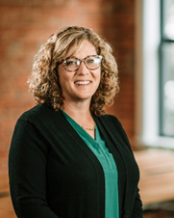
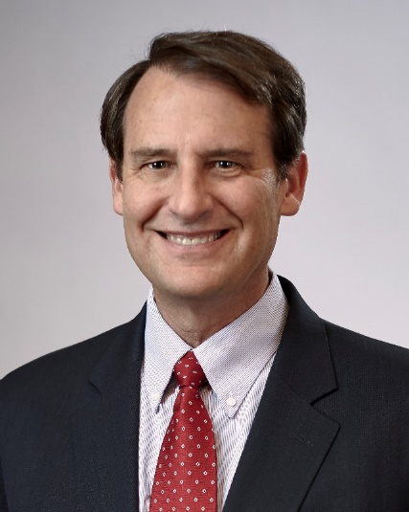
ESOP FEASIBILITY
Dawn Goestenkors
Chuck Bachman
Menke & Associates, Inc.
cbachman@menke.com

Slide 3
SESSION OUTLINE
Part I. WHO IS A GOOD ESOP CANDIDATE?
Part II. PROFESSIONAL ADVISORS
Part III. VALUATION PROCESS
Part IV. TAX BENEFITS
Part V. FINANCING
Part VI. ESOP PARTICIPANTS

Slide 4
Part I. Who is a Good/Bad ESOP Candidate?
Owner’s motivation and objectives:
Are they seeking to implement an exit strategy or desire some liquidity?
Will they continue with the Company after the Transaction?
Do the Owners want to keep the company intact with minimal disruption?
Do the Owners seek to increase employee productivity?
Do the Owners desire to utilize corporate tax savings to increase growth/accelerate debt repayment?
Succession Management team:
Is there in place (or will there be) a competent succession management team?
Company Financial Condition:
Is the Company Profitable?
Does the Company have a strong predictable revenue stream and cash flow?
Does the Co. have manageable prospective capital expenditure requirements?

Slide 5
Who is a Good/Bad ESOP Candidate? (Cont.)
Realistic Assessment of Company Value:
Are the Owners willing to accept FMV for their stock?
Are the Owners looking to be paid out all at once or over time?
Do the Owners desire to utilize corporate tax savings to increase growth/accelerate debt repayment?
Employee Census:
Does the Company employ more than 15 employees?
Ability to repay ESOP debt:
Does the Company have the ability to make recurring contributions to repay the ESOP loan?

Slide 6
Who is a Good/Bad ESOP Candidate? (Cont.)
Corporate culture:
Does the Company foster an “ownership culture”?
When Employees own a piece of the company, studies show increased motivation, productivity, profitability, retention, etc.
Post Closing Governance:
If the Owners are staying with the Company, are they willing to allow for independent directors to control or be on the Board?
Post Closing Involvement in the Business:
Are the Owners willing to dilute “control” at the Board level and/or at the Management level?

Slide 7
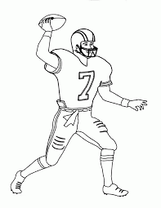
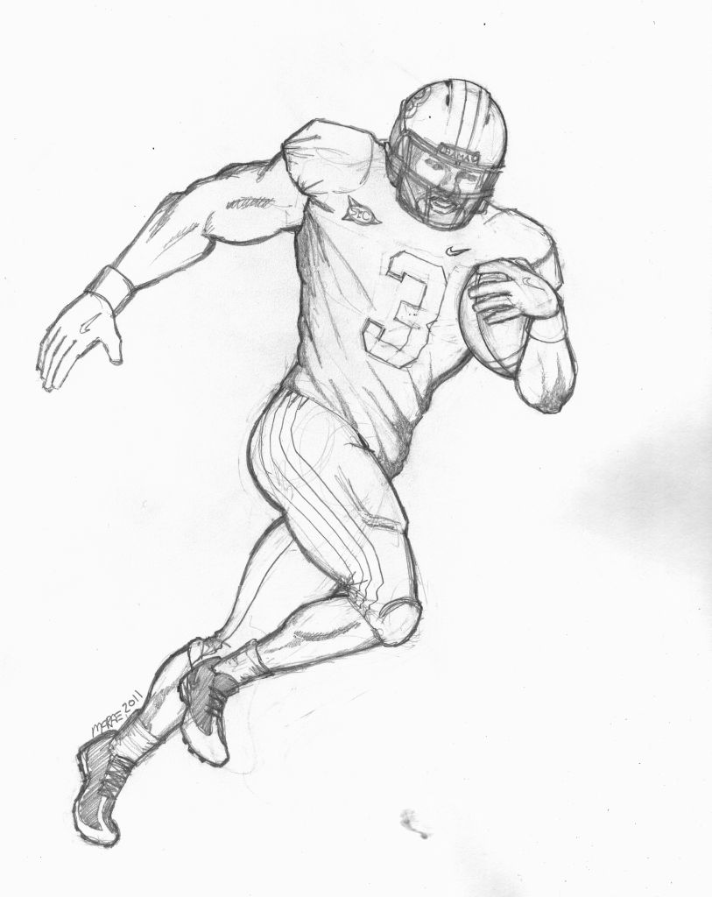
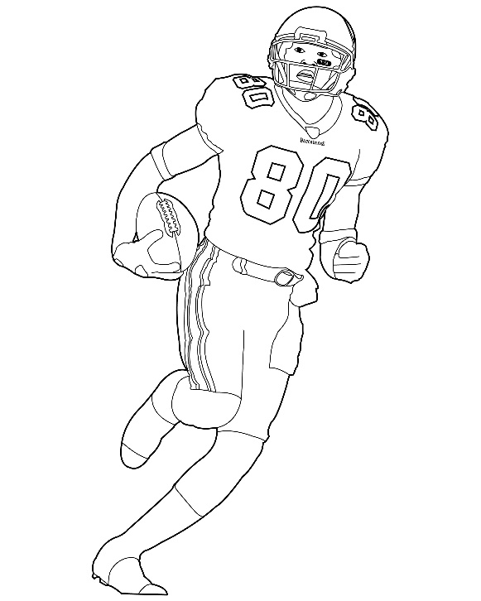
Part II. PROFESSIONAL ADVISORS

Slide 8
PROFESSIONAL ADVISORS
Seller & Company’s Professional Advisors
Seller’s Financial Advisor / Appraiser
ERISA Attorney
Local Attorney
CPA
TPA/ Recordkeeper for ESOP Administration
Investment Banker

Slide 9
PROFESSIONAL ADVISORS
ESOP Trust’s Professional Advisors
Trustee
Appraiser / Financial Advisor for Trustee
Trustee’s ERISA attorney

Slide 10
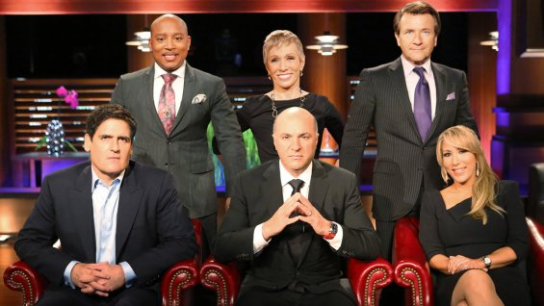
Part III. VALUATION PROCESS

Slide 11
Engage the Independent ESOP Appraiser
Guidance for Trustees in Selection of Valuation Advisor, -per Various DOL Process Agreements
The Trustee should thoroughly vet potential financial advisors to determine if they are qualified and approved to use
-Some trustees do this with each engagement while others due this as an annual process for all advisors
The Trustee as part of that process collects information from each financial advisor including:
-The firms experience valuing ESOP companies
-Professional affiliations
-Internal controls for issuance of a valuation report and opinions
-Sample valuation report for review
-References
If a trustee approves a list of financial advisors when they are selecting an advisor for a potential engagement they consider who is the best fit based on items such as:
-Past client experience
-Industry experience
-Location
-Capacity

Slide 12
Financial Advisor Role – Advisor to Trustee
Develop defensible fair market value range
Post-Transaction Cash Flow Analysis
Analyze and assist Trustee in negotiating all deal terms
Analyze the benefit to ESOP participants (ESOP loan terms)
Provide 2 key deliverables to the Trustee regarding value and the terms of the deal

Slide 13
Financial Advisor Role – Advisor to Trustee
In the capacity of advisor to the Trustee (buy-side), providing key advice on all matters that the Trustee will negotiate with the Selling Shareholder(s)
Key Skillsets:
Valuation, valuation, valuation….
Understanding terms of a deal beyond the valuation (terms applicable in an ESOP or non-ESOP sale)
Communication – written and verbal (all Buy-side and Sell-side members)
Ability to work with Sell-Side Team to navigate and assist the Trustee in negotiating a deal
Ability to be responsive in a fast-paced transaction environment to meet transaction milestones/deadline

Slide 14
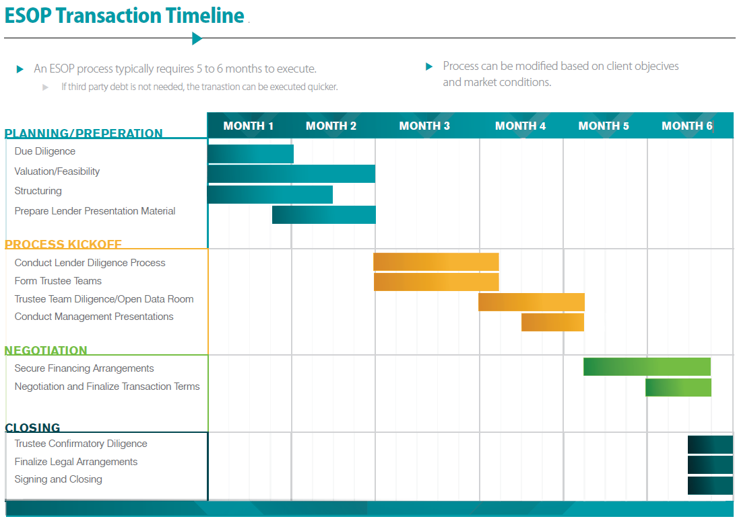
Part IV. TIMELINE

Slide 15
Part V. Tax Benefits
Corporate Taxes: Pre-tax dollars used to buy out owners (C corp or S Corp)
Personal Taxes: No capital gains if Section 1042 election (C corp only)

Slide 16
ESOP Purchase vs. Shareholder Agreement (Redemption)
Stock Price
After-tax Cost
ESOP purchase
$1,000,000
$ 600,000
Redemption
$1,000,000
$1,000,000

Slide 17
“Double Duty for the Dollar”
1. Buy/Sell Agreement
Amount
After-tax Cost
401(k) contribution
$1,000,000
$ 600,000
Redemption
$1,000,000
$1,000,000
Total
$2,000,000
$1,600,000
2.ESOP Approach
ESOP Contribution & Purchase
$1,000,000
$ 600,000

Slide 18
Section 1042 Requirements
Company must be a C Corp for now (change in the law starting in 2028)
ESOP must own 30% after the transaction
Seller must reinvest in “Qualified Replacement Property” (QRP) = U.S Companies
Additional Requirements

Slide 19
Section 1042 “Qualified Replacement Property” (QRP)
Any “U.S.” corporation, public or private
Equity or debt securities
Passive investments, gov’t securities, and mutual funds don’t qualify

Slide 20
Part VI. Financing: How Do I Pay For It?

Slide 21
ESOP Financing Options
Bank or other financial Institution
Seller Financing
Company Cash
Combination of the above

Slide 22
Bank
Bank Lenders
Most major financial institutions welcome the idea lending to ESOP owned companies
Why?
ESOP companies tend to more stable
Cash flow is better – tax deduction for interest AND PRINCIPAL on the loan value

Slide 23
ESOP Loan Balance Sheet Effect
Equity is Reduced initially
Bonding issues due to temporary negative impact to shareholders equity?

Slide 24
Part VII. The ESOP Participants
ESOP shares are owned by a Trust, not by the Employees directly
Employees are “beneficial”, not “direct” owners of stock
Trustee votes ESOP shares, except in special cases
The Trustee’s job is to represent the ESOP’s interests
Participants have the economic benefit of owning stock, with virtually no corporate governance rights
Employees are not entitled to company financial statements or the ESOP valuation report

Slide 25
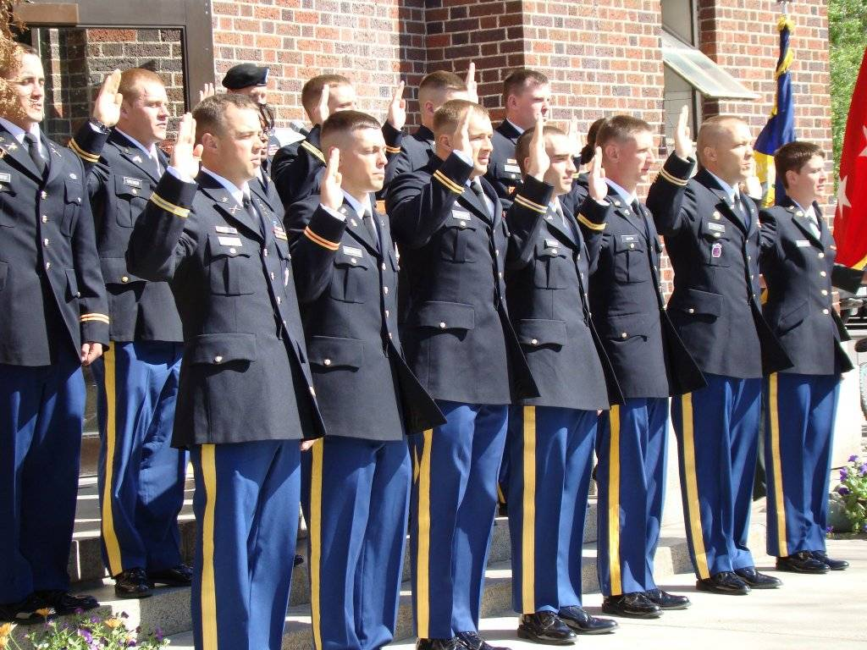
Second Team Management
25

Slide 26
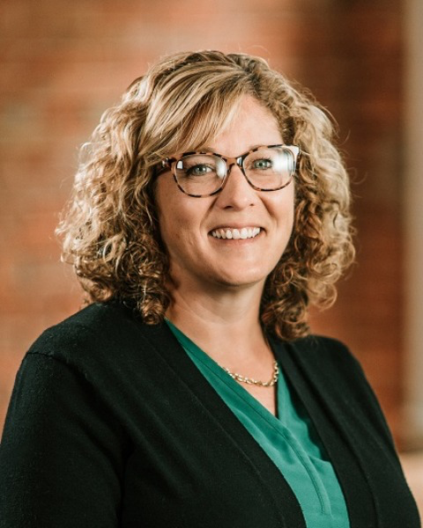
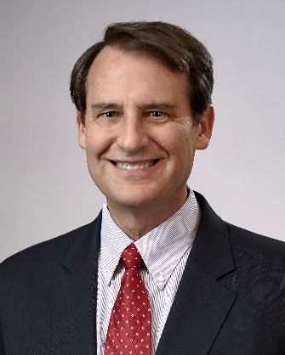
Thank You for Attending!
Please complete the session evaluation!
Chuck Bachman
Senior Corporate Counsel
Menke & Associates
(415) 318-1003
CBachman@Menke.com
Dawn Goestenkors Executive Vice President TI-TRUST, Inc. Dir. Tel.: (217) 221-8654 Cell: (217) 430-1664
Email: dawn.g@ti-trust.com

